Slide 1
TextonBoost
By: Ben Levinsky, Joe Mogannam, Blair Bickel

Slide 2
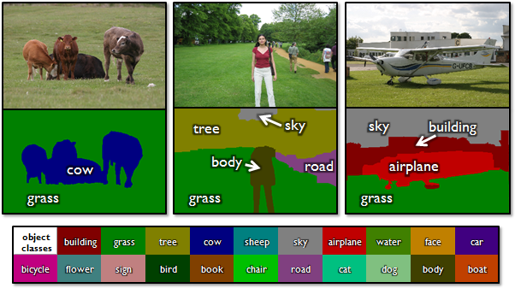
What is TextonBoost?

Slide 3
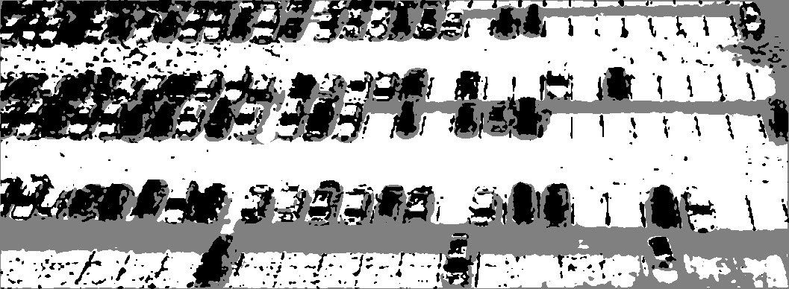
Introduction
Attempt to segment images into various classes
Classification and feature selection is achieved using boosting to give an efficient classifier which can be applied to a large number of classes.

Slide 4
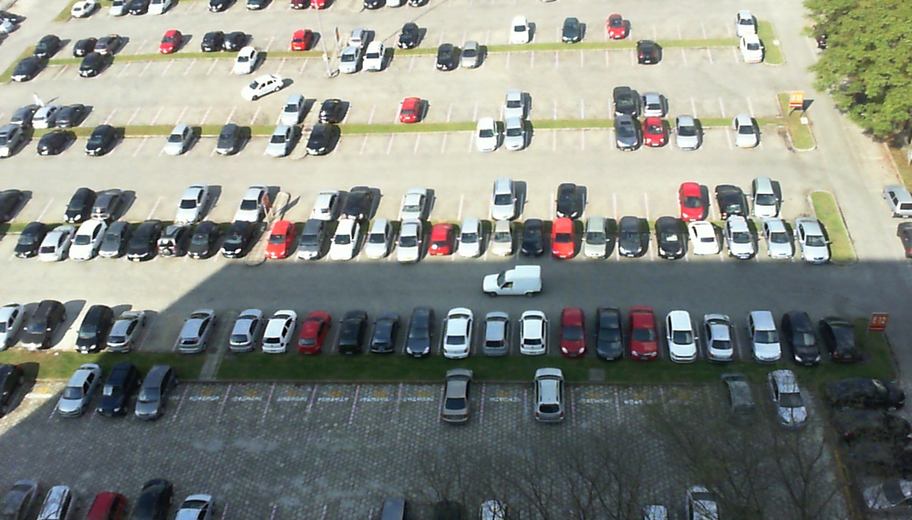
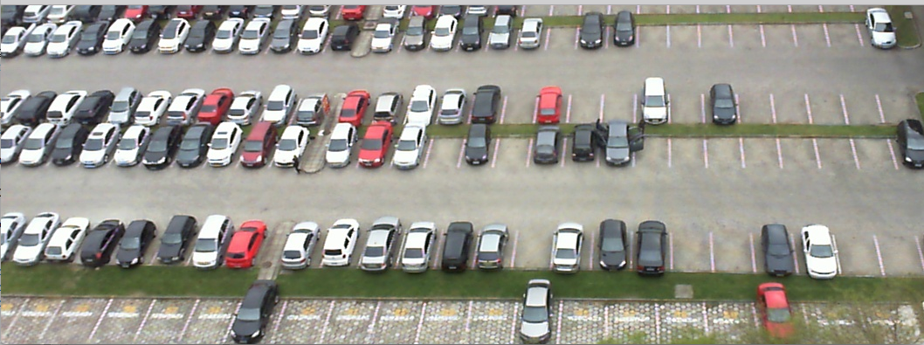
Data Sets

Slide 5
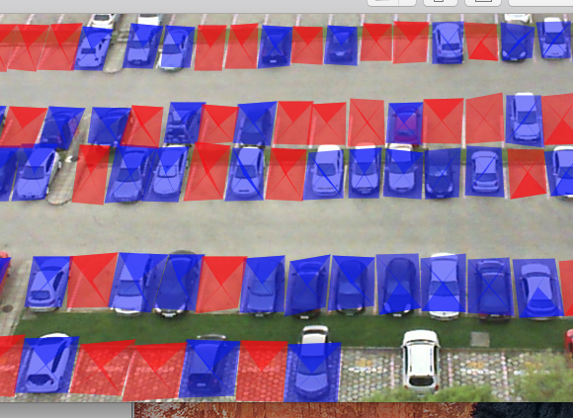
Ground Truth

Slide 6
Approach
For each pixel in an image:
Texture-Layout features are calculated
A boosting classifier gives the probability of the pixel belonging to each class
The model combines the boosting output with shape, location, color and edge information
Pixel receives final label
Image receives final label

Slide 7
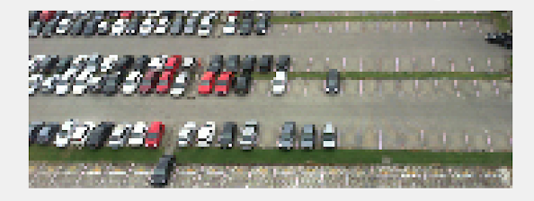
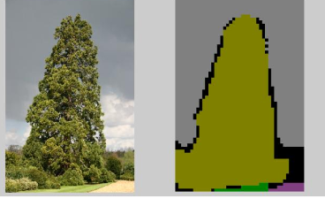
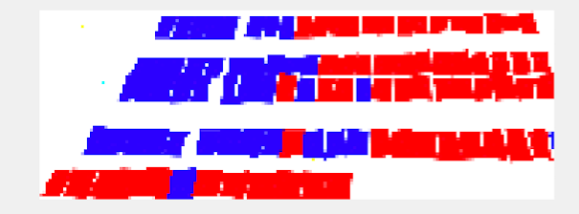
Approach cont.
Input Images: cropped images to only include a small portion of the lot, so the sizes of the spots would stay consistent
Ground Truth Images: instead of every pixel being associated with a class, our GT images used approximate rectangles around cars so this cause further issues with accuracy

Slide 8
Augmenting the Code
Original Code:
Filter bank w/ 3 gaussians, 4 LoG’s, 4 first order derivatives of gaussians, 24 classes
Our Code:
Augment filter bank with SIFT to add dense sift (assumes every pixel is an interest point)
Changed algorithm to account for grayscale images
Use total of 3 classes: void, car, unoccupied

Slide 9
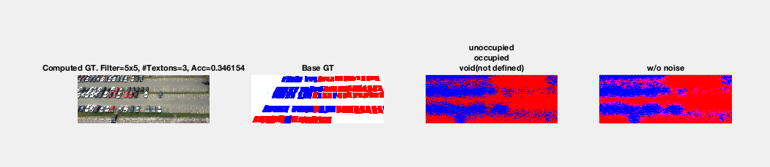
Results
Using default parameters bore most accurate results
PKLot dataset had higher accuracy than UIUC dataset

Slide 10
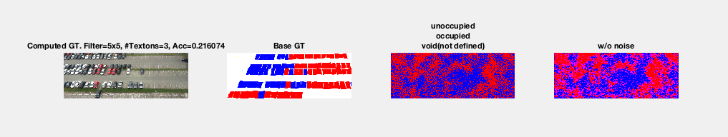
Results cont.

Slide 11
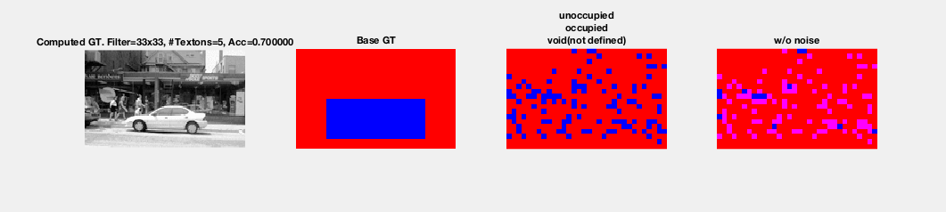
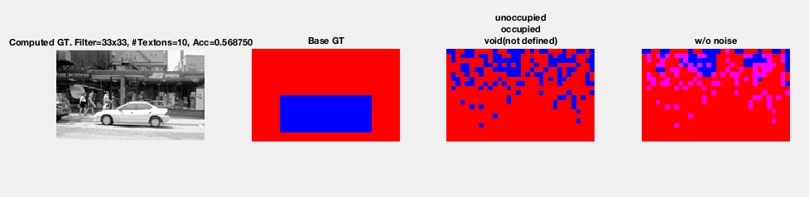
Results cont.

Slide 12
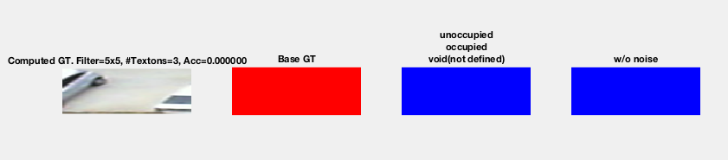
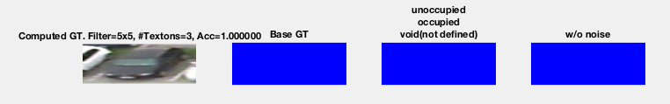
Results cont.

Slide 13
Challenges
Complete Pipeline
Introducing sift features
Understanding code-base
Number of clusters in data
Working with challenging datasets
Reducing noise

Slide 14
Knowledge Gained
Dense sift
Boosting in a real world context
Importance of dataset

Slide 15
Future Improvements
Number of Clusters

